Slide 1

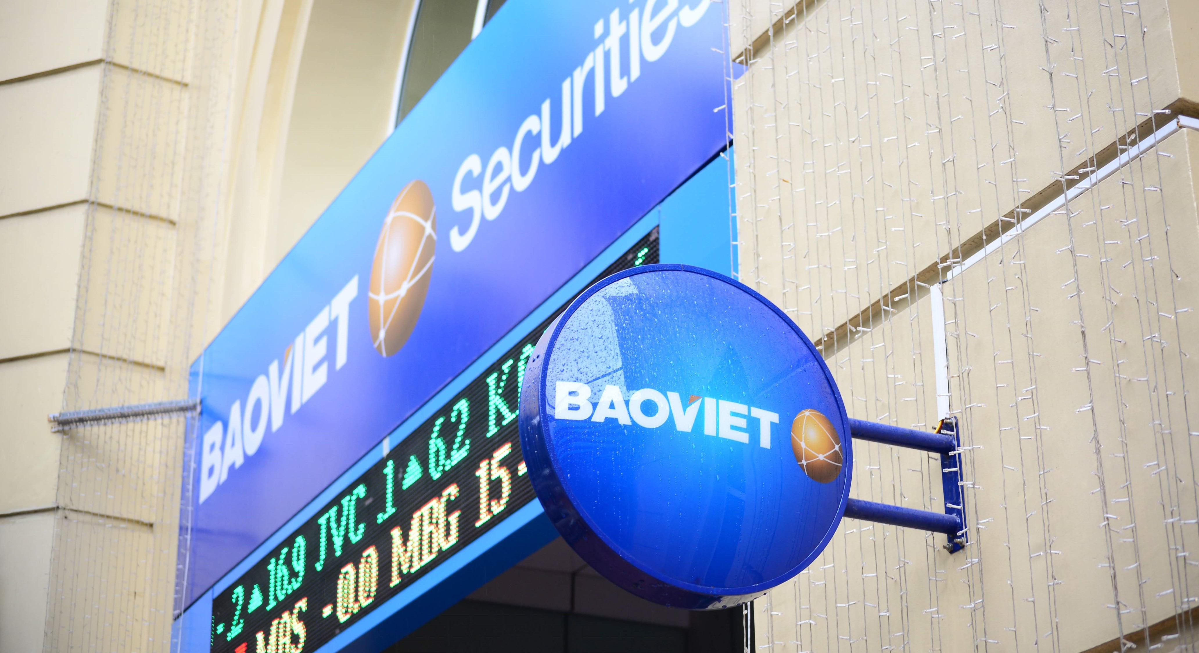
INVESTOR RELATIONS NEWSLETTER
Frist Quarter 2026
BAO VIET SECURITIES JOINT STOCK COMPANY

Slide 2

CONTENTS
STOCK INFORMATION
MARKET HIGHLIGHTS
BUSINESS HIGHLIGHTS
CORPORATE HIGHLIGHTS
OTHER INFORMATION
BAO VIET SECURITIES JOINT STOCK COMPANY

Slide 3
STOCK INFORMATION
Exchange | HNX
Price range | VND 24,300 – 32,600
Market cap | VND 1,927.74 bn
Shares outstanding | 72,200,145
Average daily trading volume | 309,254
Foreign ownership | 1.20%
EPS | 3,110
P/E | 8.59
Beta | 1.38
* Financial indicators updated by the end of March 31, 2026
* Price range is defined from January 01 to March 31, 2026
BAO VIET SECURITIES JOINT STOCK COMPANY

Slide 4

MARKET HIGHLIGHTS
OPPORTUNITIES
CHALLENGES
Positive economic growth. Q1 GDP grew by 7.83%, outperforming the same quarter last year (Q1 2025: +7.07%). Given a high growth target and various resolutions and policies introduced, the economy is expected to continue growing strongly in the following quarters, creating a favorable business environment for listed companies.
Robust performance for listed companies in Q1. Profit after tax of firms in the BVS-80 is projected to grow by 9.5% in Q1, and accelerate to 11.2% for full-year 2026.
Vietnam’s stock market was upgraded to FTSE’s Secondary Emerging Market in the semi-annual review 2026, taking effect since September 2026. Beyond attracting foreign capital inflows, the upgrade would strengthen Vietnam’s standing on the global investment map, enhancing its long-term appeal to both domestic and international investors.
Tensions in the Middle East led to global capital outflows from risk assets and higher energy prices, disrupting supply chains and heightening inflationary pressures. This, in turn, prompted central banks to adjust their monetary policies, keeping interest rates at elevated levels.
Heightened domestic inflation and exchange rate risks have made accommodative monetary policy increasingly challenging. In addition, liquidity pressures intensified as deposit growth lagged behind credit growth, pushing domestic deposit rates to remain on an upward trend in Q1.
Foreign investors continued to net sell in Q1. Foreign investors continued to record net selling in Q1. During the first three months of the year, net foreign outflows on HOSE amounted to VND 31 trillion, marking the twelfth consecutive month of net selling. In addition, nearly VND 3 trillion was withdrawn via ETFs.
BAO VIET SECURITIES JOINT STOCK COMPANY

Slide 5
MARKET HIGHLIGHTS
Escalating tensions in the Middle East negatively impact global stock markets. The conflict in March dampened most of the gains recorded in the first two months of the year, causing the VN-Index to close the quarter down more than 6%.
”
”
The VN-Index closed the first quarter at 1,674.49 points, down 110 points, or 6.16%, compared to the end of 2025. On the HNX, the HNX-Index closed the quarter at 250.98 points, up 2.21 points, or 0.89%. Despite the decline in the VN-index, market liquidity remained strong, with the average daily trading value across all three exchanges reaching VND 35,005 billion per session, up 18.62% QoQ and 92.84% YoY.
The market showed signs of a rebound in April, as the VN-Index was supported by several large-cap stocks, retesting the peak recorded in January. At the close of the trading session on April 23, the VN-Index reached 1,870.36 points, up 195.87 points from the end of Q1 and 85.87 points from the end of 2025. However, market liquidity declined by around 22%, reflecting cautious investor sentiment and limited new cash inflows. The index’s uptrend was driven mainly by large-cap stocks, while cash flows remained narrowly concentrated.
BAO VIET SECURITIES JOINT STOCK COMPANY

Slide 6
BUSINESS HIGHLIGHTS
Despite the decline in the VN-Index in Q1, the average daily trading value remained high year-on-year, thereby supporting the Company’s business performance to remain closely aligned with its targeted revenue and profit objectives.
”
”
Realized revenue reached VND276.3 billion, completing 27.6% of the target and reaching 162% of the same period last year, driven by core businesses, including brokerage, lending, and proprietary trading.
Brokerage revenue reached VND98.7 billion in Q1, completing 25.4 of the target and rising by 85% year-on-year. Margin lending and advances generated VND122.1 billion in revenue, fulfilling 27.4% of the target and reaching 137% of the same period last year. For proprietary trading, the Company closely monitored market movements and adopted a flexible investment approach, thereby recording investment gains of VND 45 billion, fulfilling 44% of the target and tripling the result recorded in the same period last year.
The Company’s realized PAT in Q1 reached VND61.6 billion, completing 29.3% of the target and reaching 145.1% of the same period last year.
(Unit: VND bn)
Realized revenue Realized PAT
Q1 2025 Q1 2026
BAO VIET SECURITIES JOINT STOCK COMPANY

Slide 7


CORPORATE HIGHLIGHTS
- Product & Services
The Company continued to roll out incentive programs such as cash rewards for new clients, preferential fees, interest-free loans for the first five days, and margin lending rates from 5.8%, enhancing clients’ investment capacity and supporting the performance of BVSC’s brokerage business.
BAO VIET SECURITIES JOINT STOCK COMPANY

Slide 8

CORPORATE HIGHLIGHTS - Recruitment – Training
NEXT GEN 2026
The “Next Gen” program officially returns in 2026 to Hanoi and Ho Chi Minh City, marking its 7th consecutive year of implementation and affirming its role as one of the company’s key young talent development initiatives. The program aims to recruit and train candidates for the Individual Customer Investment Advisory Specialist position – a role that serves as a bridge between clients, businesses, and the stock market.
BAO VIET SECURITIES JOINT STOCK COMPANY

Slide 9
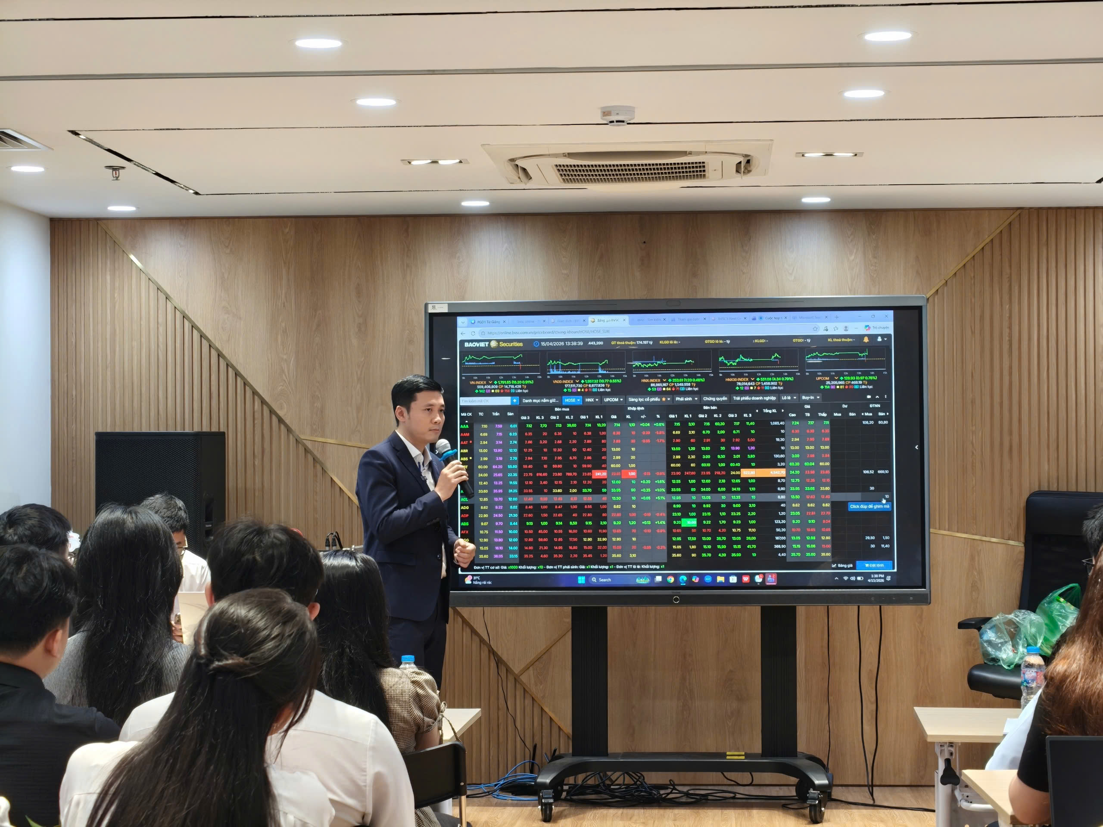
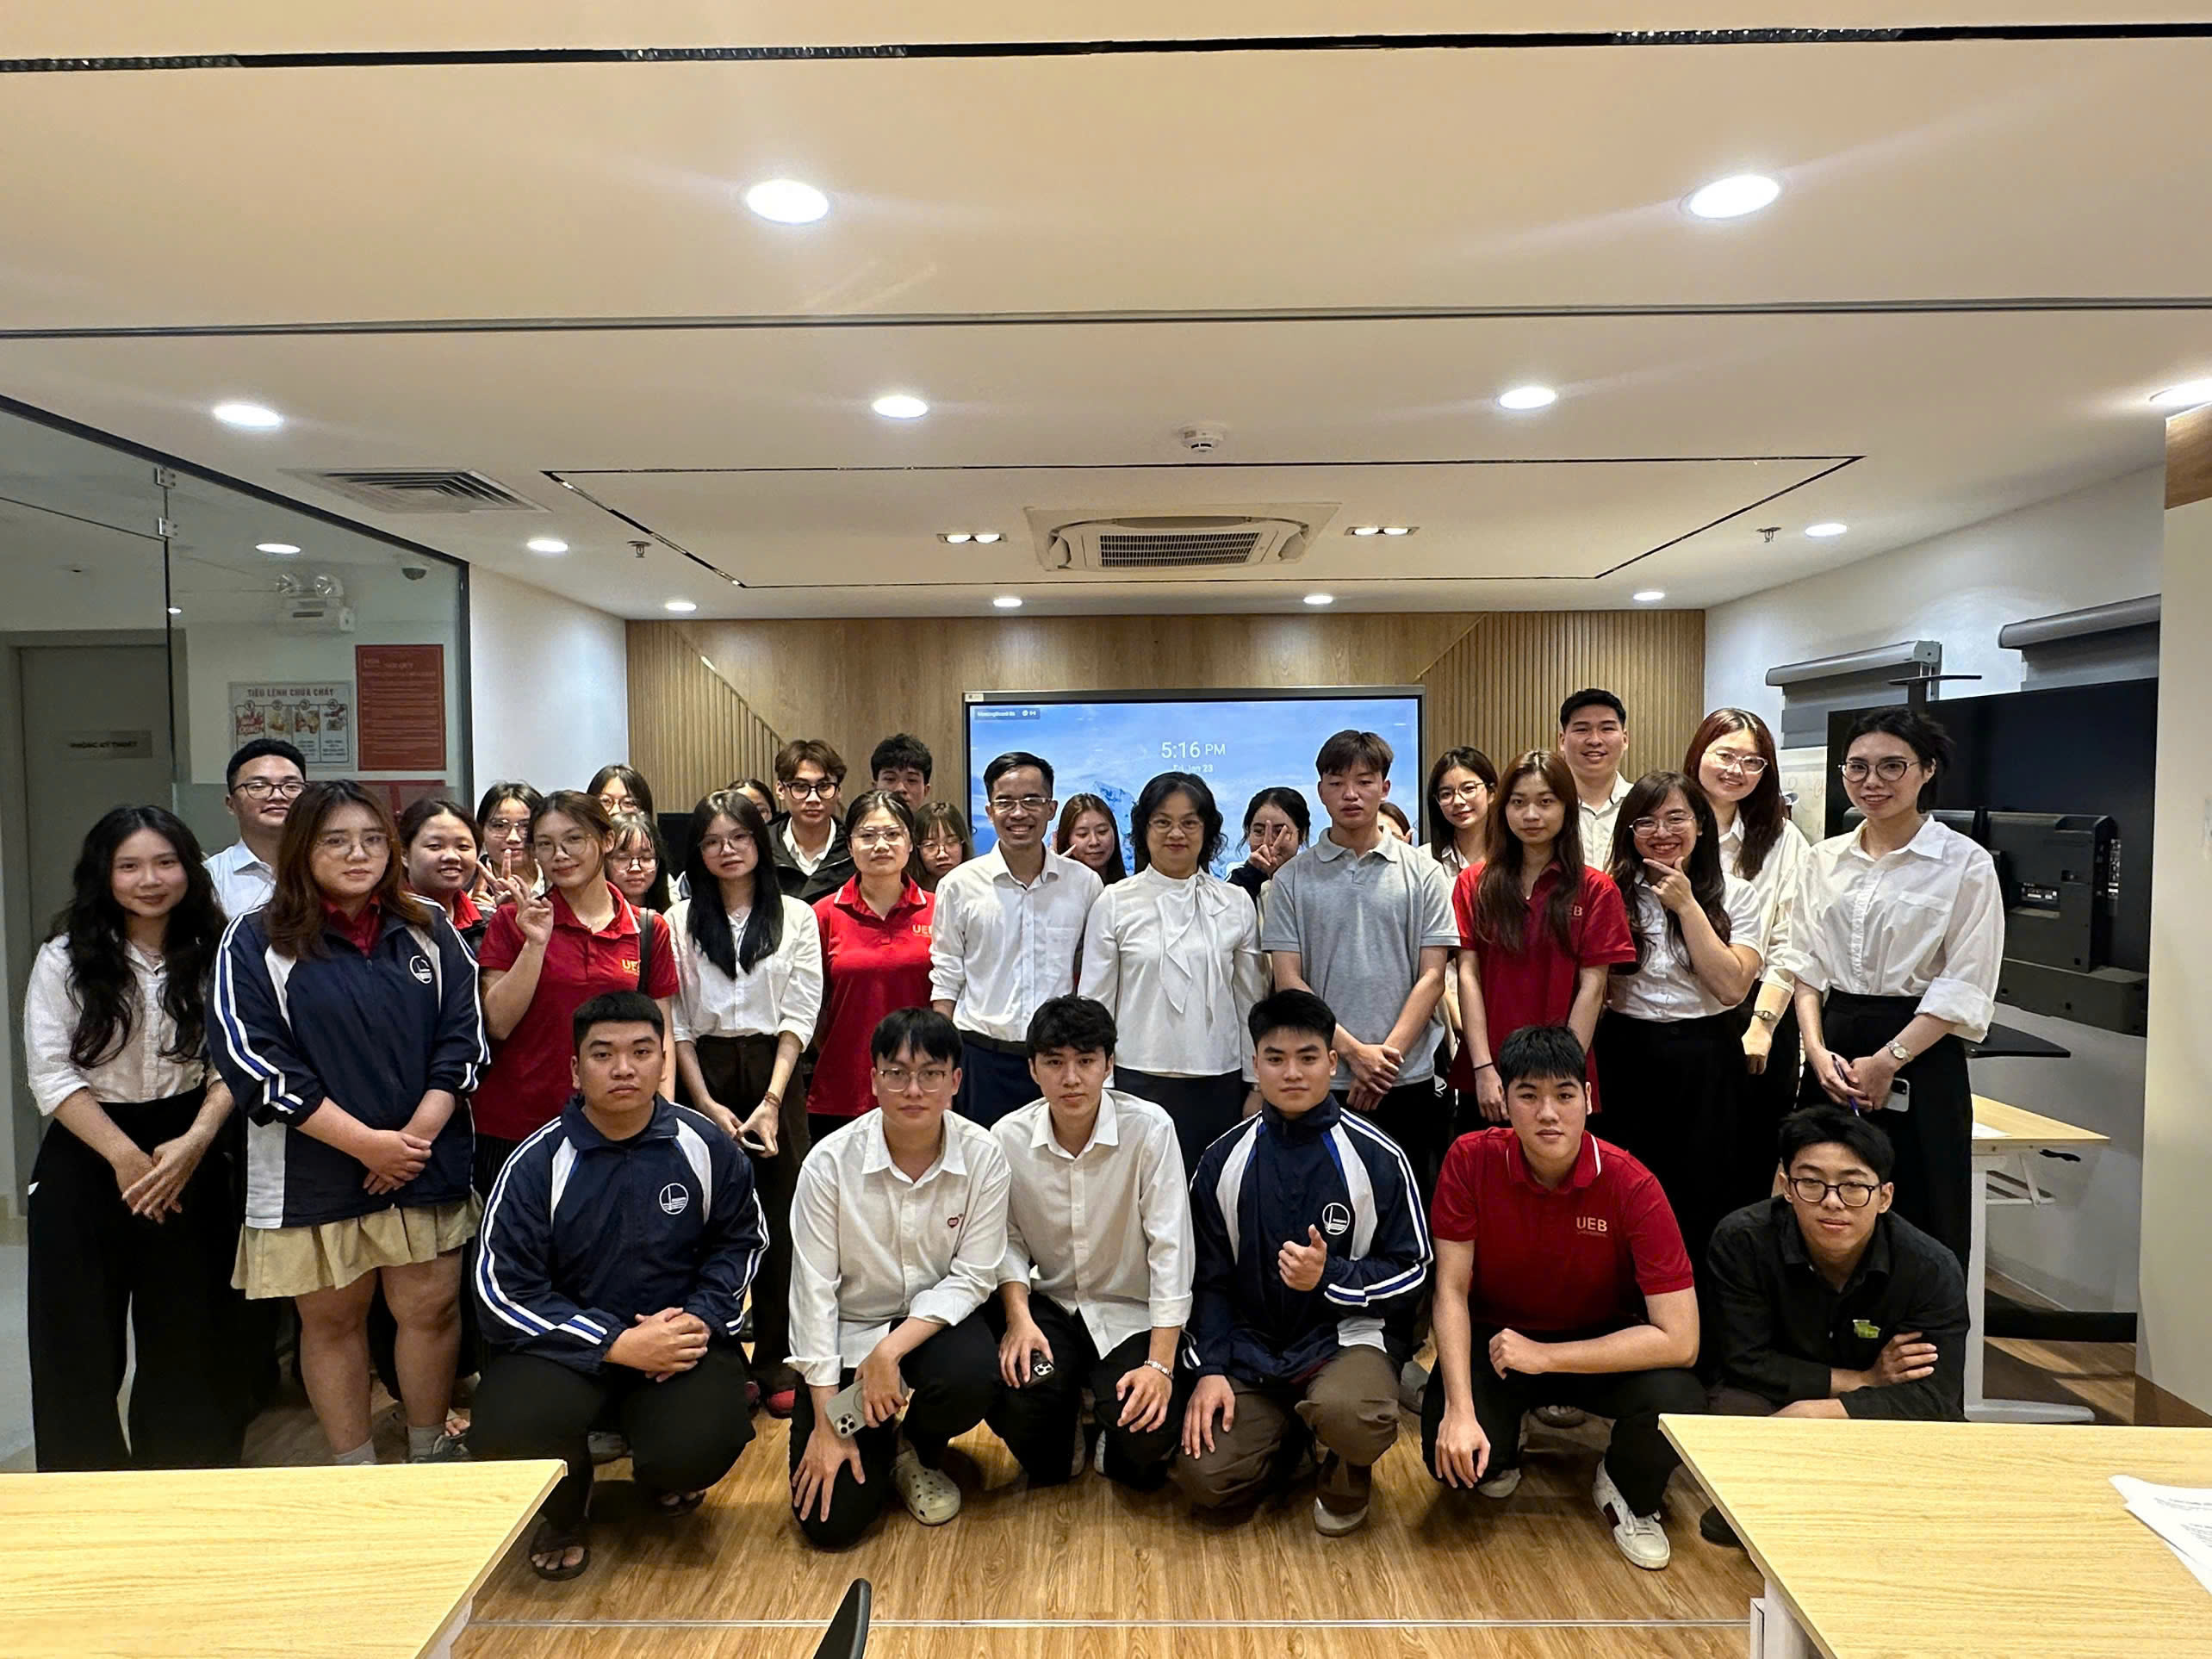

CORPORATE HIGHLIGHTS
“FROM LEARNING TO EARNING” 2026 KICK-OFF
In the first quarter, the “From Learning to Earning” program officially returned, kicking off a series of activities for 2026 with the goal of bringing students closer to the realities of the financial and stock market. The program saw active participation from students of SAPP Academy, the Academy of Finance, the University of Economics – VNU (UEB), and Ton Duc Thang University (HCMC). Through the program, students not only gain access to foundational knowledge but also directly observe and experience how the market operates, from joining daily briefings to trying out simulated trading activities. The journey is structured into three phases: Knowledge Experience – Skills Experience – Investment Experience.
As a result, the program helps enhance the Company’s brand awareness among young customers, while also building a pipeline of potential clients and talent to support its long-term sustainable growth strategy.
BAO VIET SECURITIES JOINT STOCK COMPANY

Slide 10
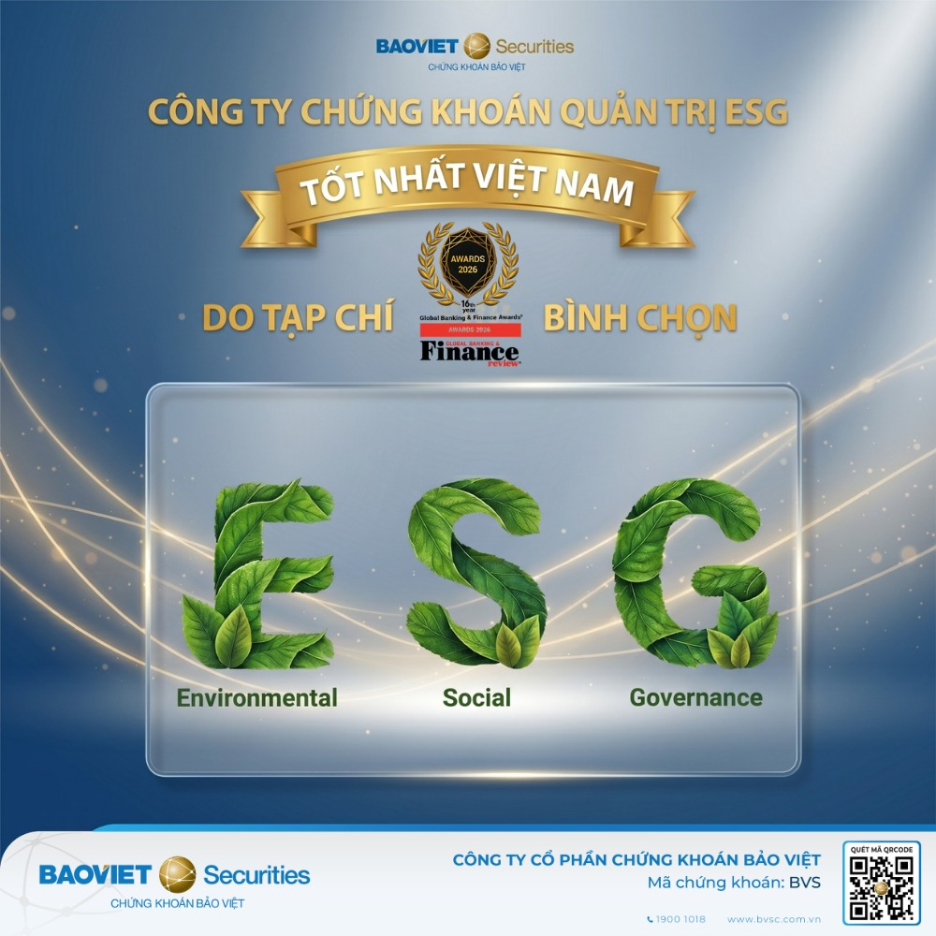
CORPORATE HIGHLIGHTS
BVSC HONORED AS “BEST SECURITIES COMPANY IN ESG GOVERNANCE IN VIETNAM 2026” BY GLOBAL BANKING & FINANCE AWARDS
Continuing its recognition for strong corporate governance domestically, BVSC has been honored as the “Best Securities Company in ESG Governance in Vietnam 2026” by the Global Banking & Finance Awards. The award acknowledges the Company’s consistent efforts in integrating Environmental (E), Social (S), and Governance (G) factors into its strategy and business operations.
BVSC remains committed to sustainable development, enhancing transparency, and strengthening risk management. To create long-term value, the Company aims to balance the interests of stakeholders while improving operational efficiency and reinforcing investor confidence.
BAO VIET SECURITIES JOINT STOCK COMPANY

Slide 11
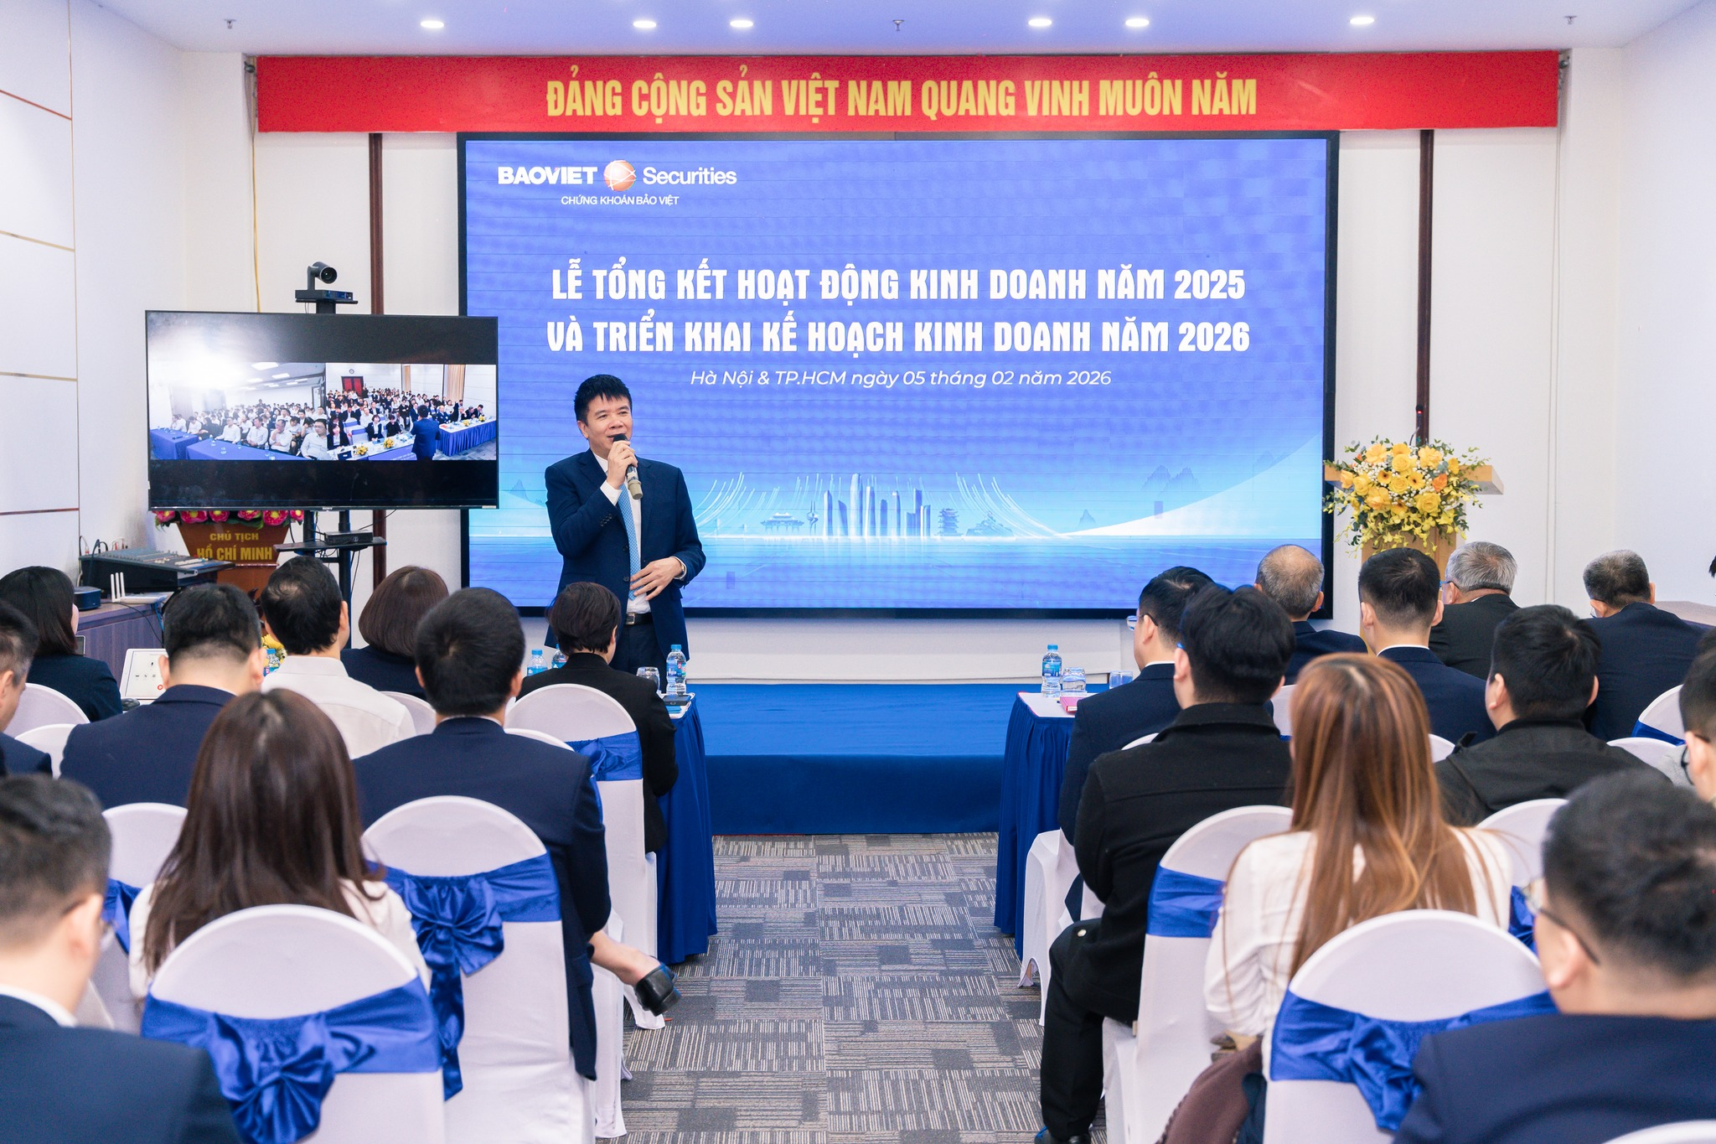
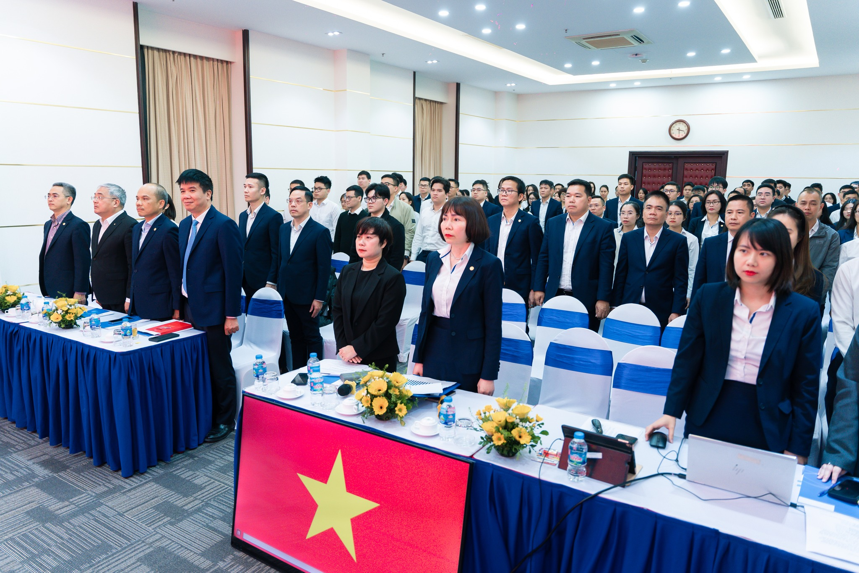
CORPORATE HIGHLIGHTS
2025 YEAR-END REVIEW CONFERENCE
In February, the Company held its 2025 Year-End Review Conference, where the Management Board conducted a comprehensive evaluation of business performance and the completion level of the 2021–2025 strategic plan. In 2025, BVSC recorded revenue of VND 1,032 billion (achieving 101% of the plan) and profit after tax of VND 204.4 billion (achieving 113% of the plan). As a result, the Company successfully concluded its 2021–2025 strategy, with average annual revenue and profit growth reaching 14.8% and 14.2%, respectively, and an average ROE of 9.4% per year. In addition to financial targets, BVSC also fulfilled its non-financial objectives, including accelerating digital transformation and applying AI in business operations and corporate governance.
In 2025, the Company further reinforced its strong governance foundation, with a clear governance structure, a strong emphasis on standards and transparency in information disclosure, and a continuous commitment to improvement in line with market best practices. These efforts were recognized through awards such as the Top 10 Listed Companies with Best Corporate Governance at the HNX Members Conference and the Listed Company Awards organized by the SSC and HOSE.
Building on this foundation, the Company has set its direction for 2026 with a target profit growth of approximately 3%, while remaining committed to sustainable development, enhancing operational efficiency, and creating long-term value for shareholders.
.

Slide 12
OTHER INFORMATION
PLAN FOR HOLDING THE 2026 ANNUAL GENERAL MEETING OF SHAREHOLDERS.
On April 23, 2026, BVSC’s Board of Directors issued Resolution No. 15/2026/NQ-HDQT regarding the organization of the 2026 Annual General Meeting of Shareholders, with the following details:
Record date for AGM: May 18, 2026
Tentative meeting date: June 16, 2026
Venue: Expected to be held at the 2nd Floor Meeting Room, Bao Viet Building, No. 8 Le Thai To Street, Hoan Kiem Ward, Hanoi, Vietnam.
BAO VIET SECURITIES JOINT STOCK COMPANY

Slide 13
THANK YOU

